Slide 1
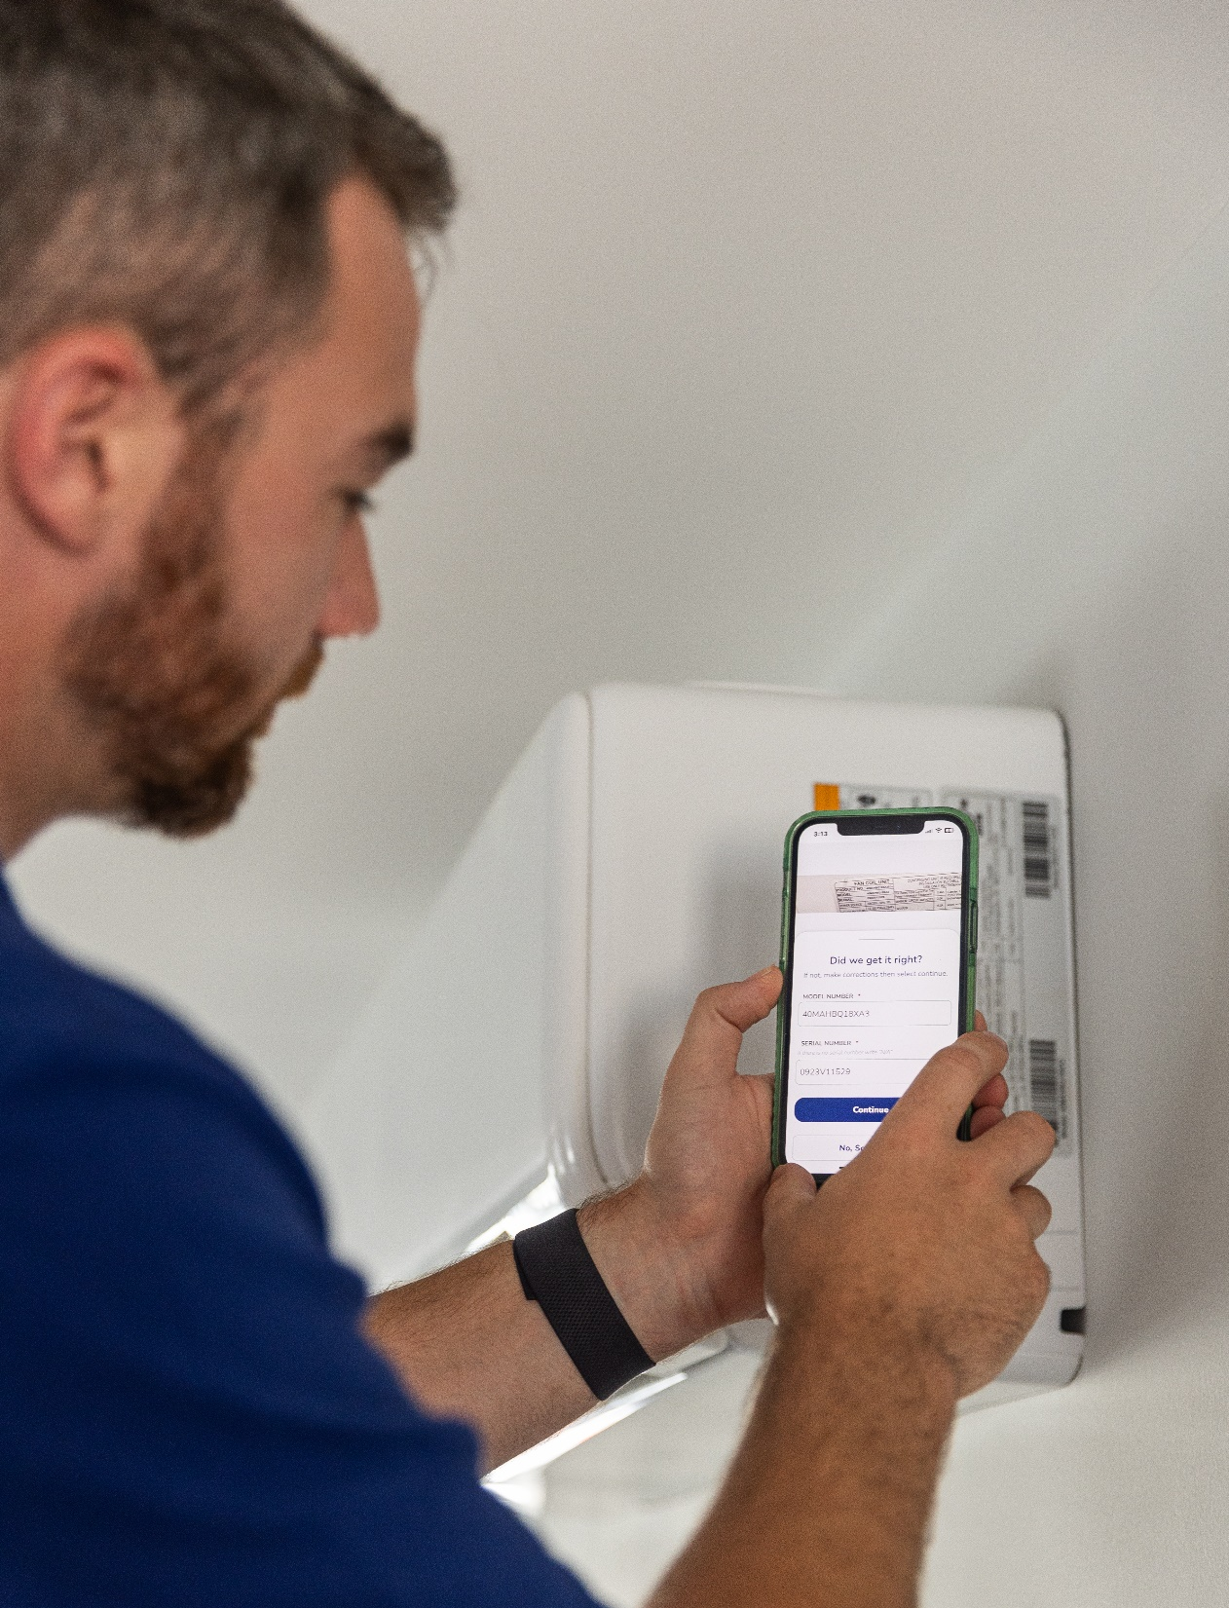
Scan. Share. Impress.
Meet Fixle: the cutting-edge solution designed to impress your homebuyers by saving them money, ensuring safety, and simplifying home ownership!

Slide 2
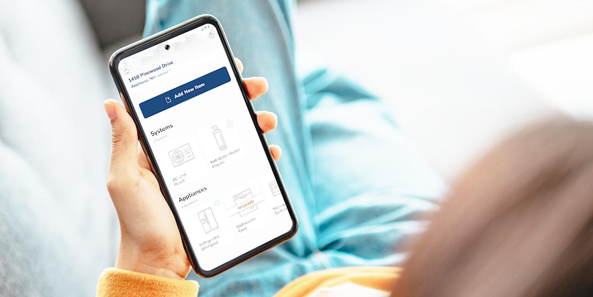
TO A TRANSFORMED, SIMPLIFIED, AND EXPANDED EXPERIENCE
FROM LOCKED INFORMATION
Currently, home inspectors collect critical property details about the home during the home inspection which are shared in a pdf report. This information is seldom used after the deal closes when the task of homeownership starts.
Fixle elevates the inspection experience by sourcing appliance manuals, system specifications, known recalls, and warranty details for major appliances in an easy-to-use app transforming the inspection into an ongoing homeownership resource.

Slide 3
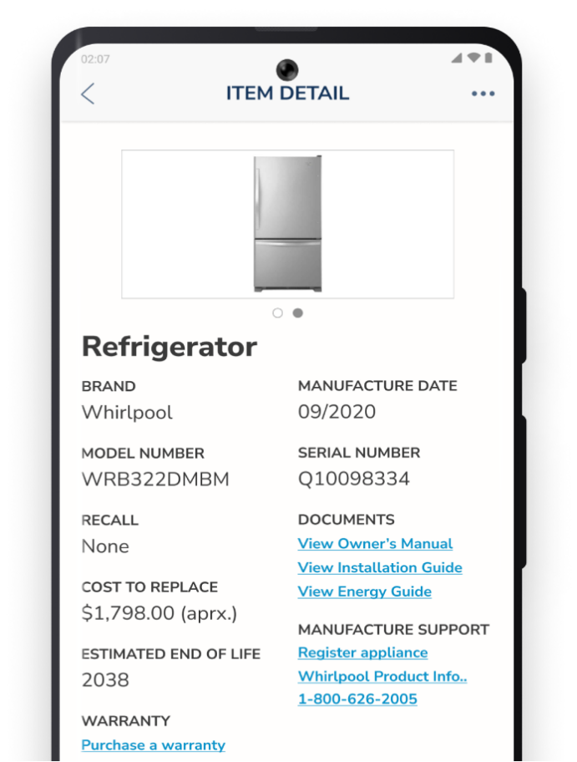
Fixle works like this
Inspectors scan a data plate to auto-populate essential system information
Fixle sends the homebuyer an email with a Fixle Home PDF report and invitation to download the app
Fixle continues to send the homebuyer notifications on any new or existing recalls
Homebuyers can add more appliances, share details with service providers, and stay ahead of system maintenance needs

Slide 4
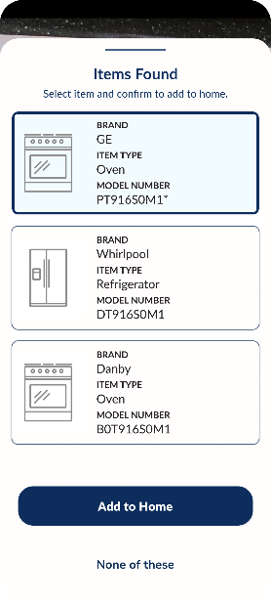
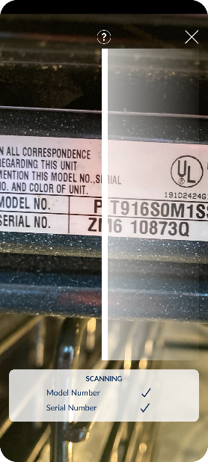
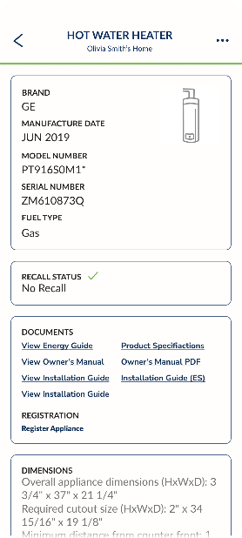
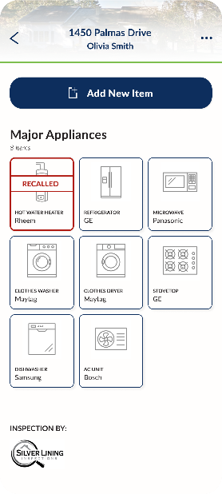
We provide more value with Fixle
DATABASE
The largest database of major
appliances in the industry puts
information at a homeowner’s
Fingertips.
LABEL RECOGNITION
The latest OCR and photographic
scanning technology using machine
learning and OCR speeds up data
capture.
CRITICAL INFORMATION
Item specifications, owner’s manuals,
recall alerts, installation documentation,
dimensions, energy efficiency guides, and end-of-life expectancy (coming soon),
save homeowners time and trouble.
FREE APP
Our inspection report becomes a
living digital resource with practical
information used to manage and
maintain the home’s major
appliances.
Notes:
LABEL RECOGNITION The latest photographic scanning technology using machine learning and OCR to speed up data capture.

Slide 5
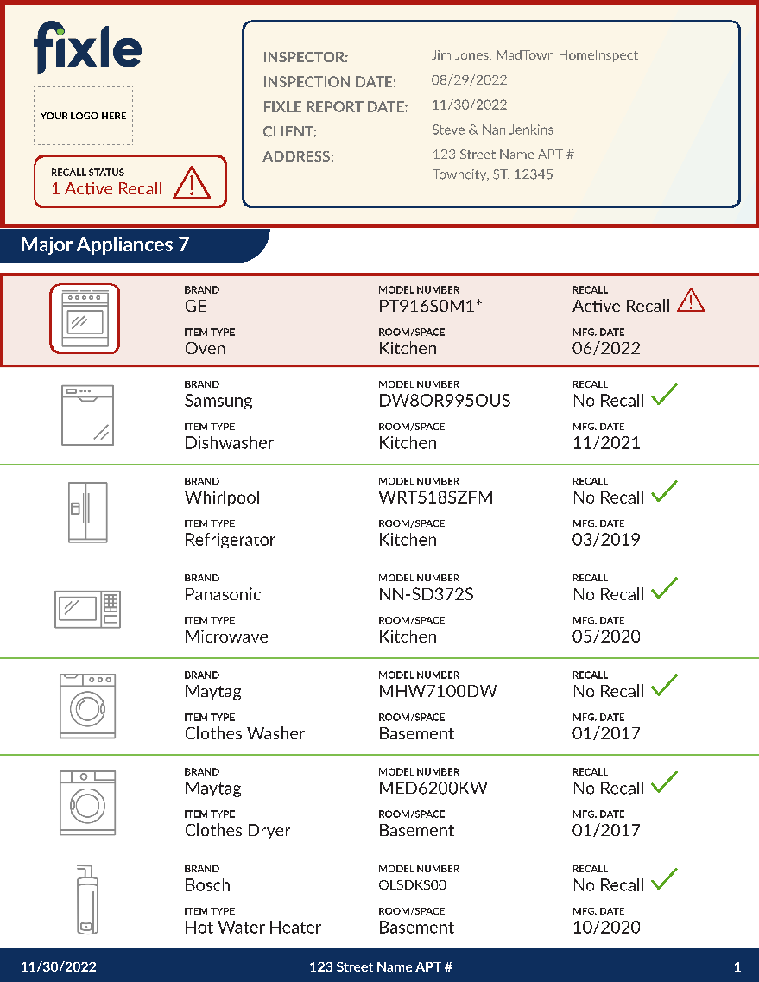
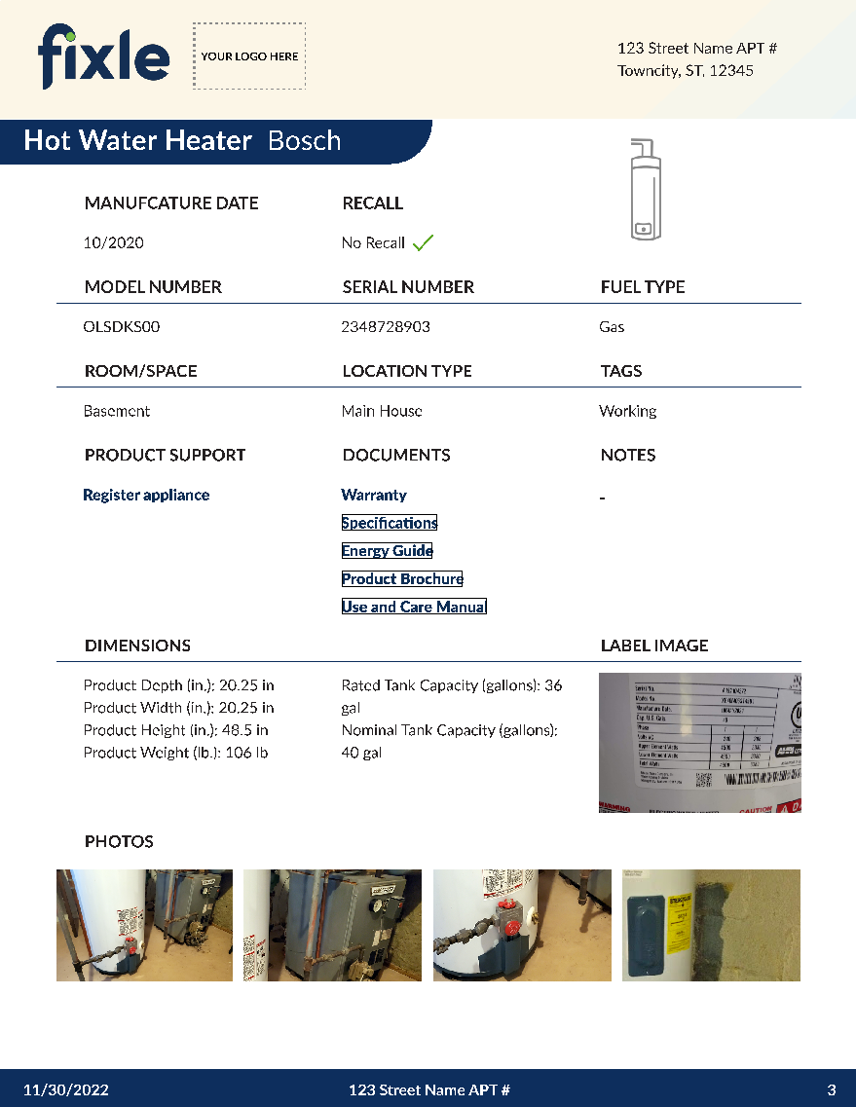
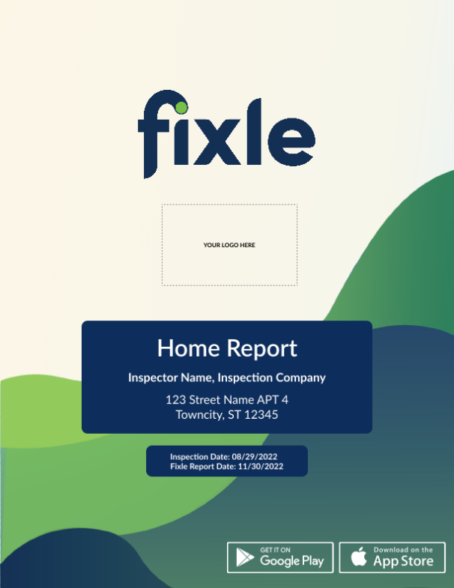
The Fixle Home Report:
Every customer will receive a link to their Fixle Home Report in addition to their final inspection report. The report documents all the details of the major appliances captured with live links to appliance documents such as owner’s manuals.
Item not found – we’re on it:
Fixle offers the largest database of system resources available. However, if an appliance is not found instantly, Fixle will source that appliance and update the app.
Fixle for consumers – cost:
Fixle is available to consumers for $5 per month (with 8 or more appliances included) from the App Store, or Google Play.
Fixle is FREE for 12 months as part of our premier inspection package.

Slide 6
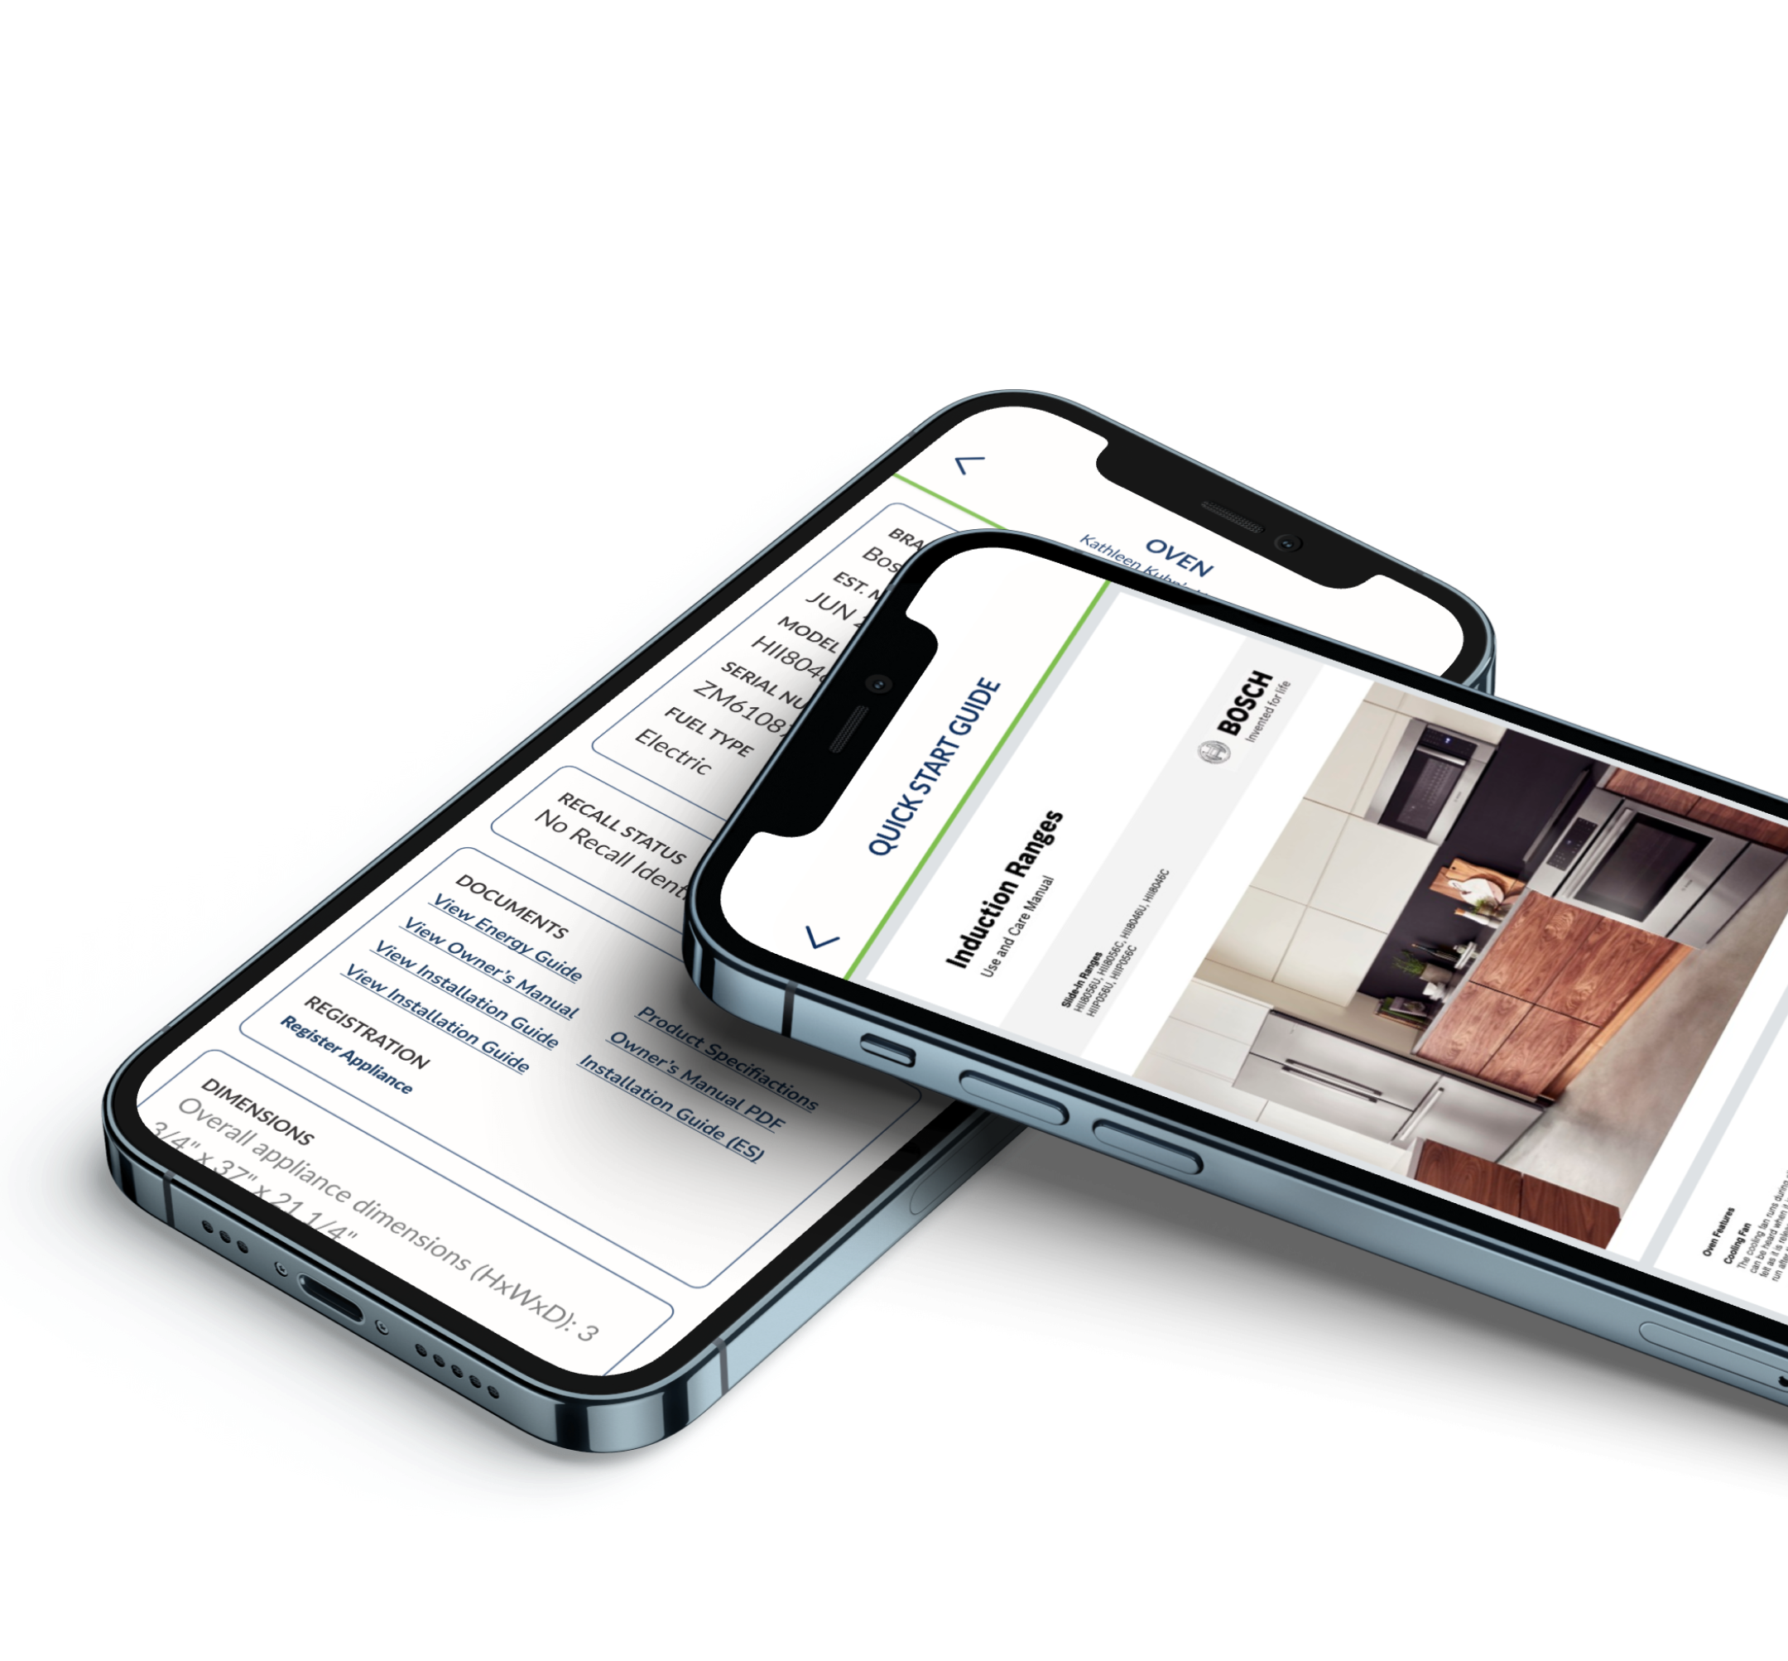
With Fixle, we give clients an easy-to-use platform to manage their new home.
CONTACT INFORMATION:

